Slide 1

Knowledge Thread 1: Session 1 (Studio 1)
Ama Simons

Slide 2
This Studio covers
Parallel Input/Output System as a Combinational Digital Lock
Sequential Lock

Slide 3
What do you need?
3 push buttons
3 330 ohms resistors
3 10kohms resistors
Wires (for connections on your bread-board as well as connections to the MCU)

Slide 4

Why are we doing this?
Parallel I/O System as a Combinational Digital Lock
Looking ahead to your next lab
Using the Moore Finite State Machine

Slide 5


Slide 6
Defining the Combinational Digital Lock
States and Inputs:
2 states – Locked or Unlocked
2 binary inputs for the code, (only one right code)
1 binary input to enter the code

Slide 7
Defining the Combinational Lock
Binary Inputs
binary value for logic testing
X = 111
CODE = 11
X = 111
1 or Unlocked
0 or Locked
X = 111
10
01
X = 111

Slide 8
Using MCU to Implement
PM2 Load or enter | PM1 Binary value input | PM0 Binary value input
1 | 1 | 1
Binary Inputs
X = 111
binary value for logic testing
X = 111
1 or Unlocked
0 or Locked
X = 111
10
01
PN1
D1 OFF
PN0
D2 ON
X = 111
PN1
D1 ON
PN0
D2 OFF

Slide 9
Entering the code and load with Push Buttons
We will use push buttons to enter the code
In Lab 1 you wired an active low push button
Button Pressed = 0
Button not Pressed 1
In Lab 2 you can use an active high push button
Button Pressed = 1
Button not Pressed = 0
PM2 Load or enter | PM1 Binary value input | PM0 Binary value input
1 | 1 | 1

Slide 10

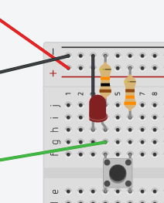
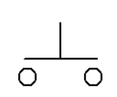

Active High Push Button with Pull Down Resistor
Circuit Diagram TinkerCad
3 V
Limits the current
330 ohms
330 ohms
LED to TEST
Input to MCU
10 Kohms
10 Kohms
Pull down resistor
Ground
LED to TEST
Input to MCU

Slide 11
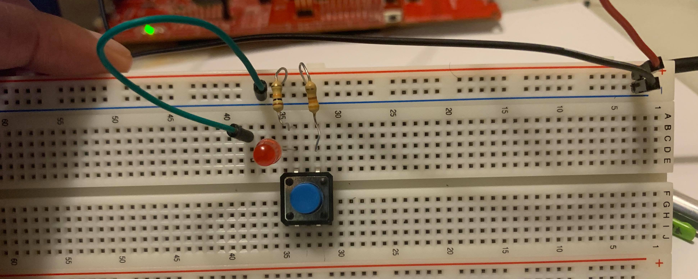
Active High Push Button with a Pull Down Resistor
3 V from the Board
10Kohms
Real Life
330 ohms
0 V from the board
Led to Test
Button

Slide 12
Exercise 0 (15 mins) : Wire 3 Active High Push Buttons for Inputs
The results of what you should have at the end of the 15 mins is uploaded to your studio table
After you have achieved these results or at the end of 15 mins come back

Slide 13
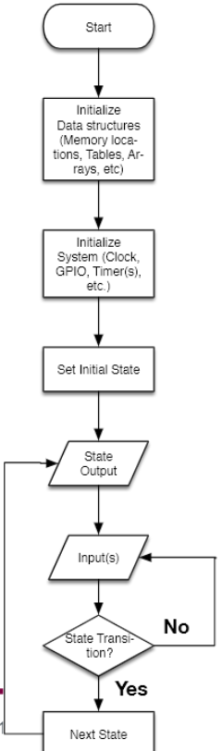


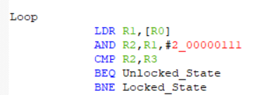
Code Run Through
Find our addresses
Turn on need ports etc.
D2 ON
PN1 | PN0
0 | 1
Set digital system to locked =

Slide 14
Exercise 2: 20 mins
Using the file that is uploaded to your studio table load the program onto your microcontroller and test the combinational lock system
There is a video of the results in your table

Slide 15
Sequential Lock
States and Inputs:
More than 2 states
1 binary input for the sequence
1 binary input to that loads the data (acts like a clock)

Slide 16
Defining the Sequential Lock
1
1
SEQUENCE = 11
01 or Locked2
10 or Unlocked
00 or Locked
0
01
01
10
0
0
1

Slide 17
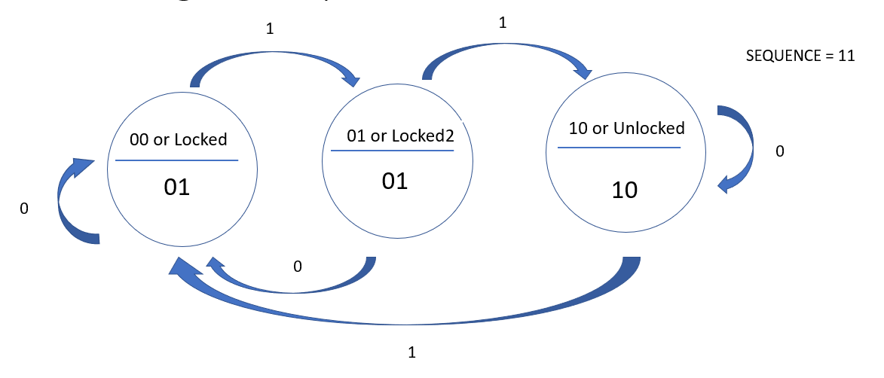
Using the MCU to Implement
PM0
PM4
Clock or load value
PN1
D1 OFF
PN0
D2 ON
PN1
D1 OFF
PN1
D1 OFF
PN0
D2 ON
PN0
D2 ON

Slide 18
End

